Slide 1
An Orientation Guide for NIH Scientific Directors
Office of Intramural Research
Office of the Director
http://irp.nih.gov/
2/25/2020 Update
Note: Links are live in presentation mode

Slide 2
Outline
Overview of NIH and the Intramural Research Program (IRP)
Overview of Scientific Director responsibilities
Key resources

Slide 3
The National Institutes of Health
NIH’s mission is to seek fundamental knowledge about the nature and behavior of living systems and the application of that knowledge to enhance health, lengthen life, and reduce illness and disability by:
Conducting research in its own
laboratories (intramural)
Providing support for research conducted
by scientists in universities, medical schools,
hospitals, and other research institutions
throughout the country and abroad
(extramural)
Training biomedical researchers
The communication of medical information

Slide 4
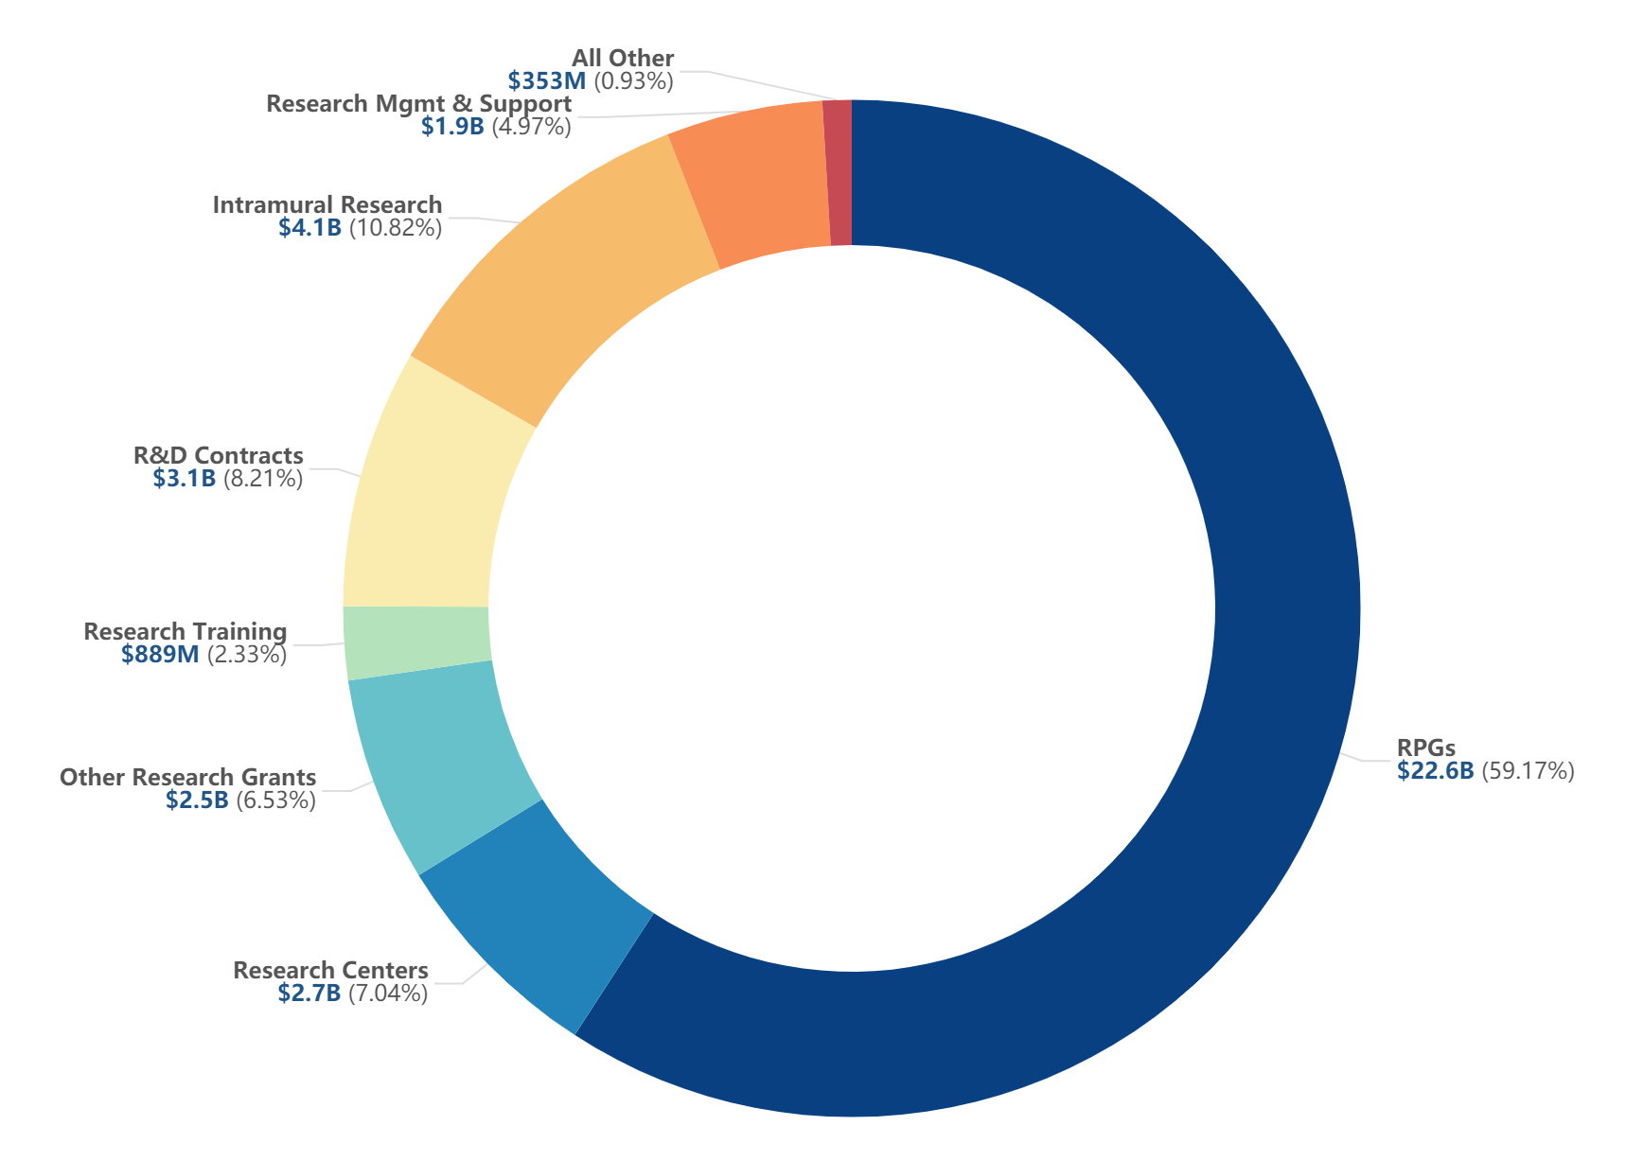
The Intramural Research Program (IRP) Represents
Approximately 11% of the NIH Budget
Total NIH Budget Authority:
Fiscal Year (FY)
2019 Operating Plan
Source: https://report.nih.gov/nihdatabook/index.aspx
Notes:
4
Data and chart description for this slide can be located at https://report.nih.gov/NIHDatabook/Charts/Default.aspx?showm=Y&chartId=4&catId=1

Slide 5
NIH consists of 27 Institutes and Centers (ICs)
NHLBI
NINR
NCATS
OD
NIBIB
NCCIH
NIEHS
NCI
NIAMS
CIT
NIDA
NEI
NIMH
CC
NIDDK
NLM
NINDS
NHGRI
NIMHD
NIDCR
NIA
NIDCD
= Extramural only
NIAAA
NICHD
NIAID
FIC
CSR
NIGMS
For IC Websites: https://www.nih.gov/institutes-nih
For IC Intramural programs: https://irp.nih.gov/about-us/our-programs

Slide 6
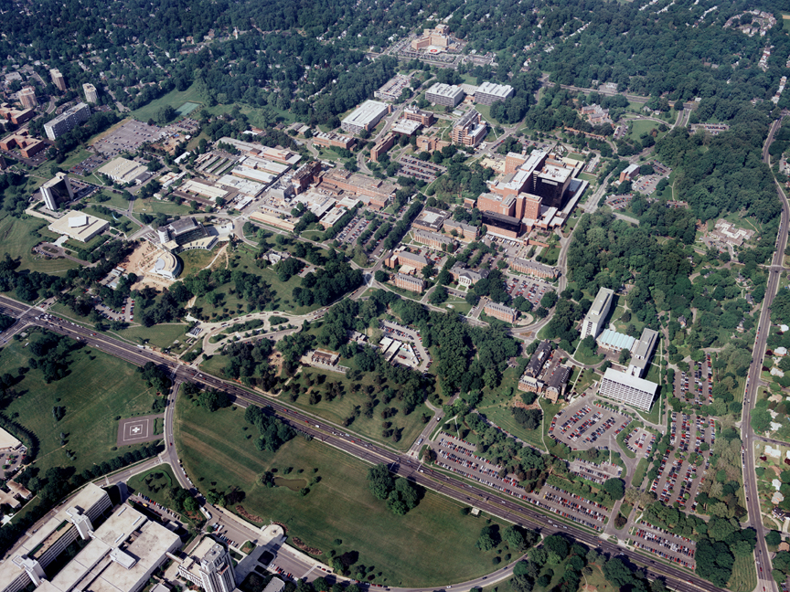
The Main NIH Campus
The NIH has 75 buildings on 322 acres in Bethesda, Maryland
Two Metro stops from Washington, DC
Notes:
6

Slide 7
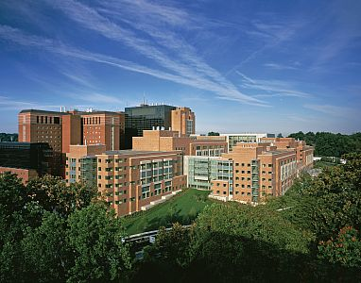
The NIH Clinical Center
“There’s no other hospital like it”
The nation's largest hospital devoted entirely to clinical research
200 inpatient beds; day hospital and outpatient facilities
Patients from all over the world
Clinical care units surrounded by research labs
Specialized infrastructure
Every patient enrolled in a research protocol; > 1,500 active protocols
Care provided at no cost to patients

Slide 8
The NIH Intramural Program Conducts Research in Multiple States
Rockville, Gaithersburg, Frederick and Baltimore, MD (NCI, NIA, NIAAA, NIAID, NIDA)
Research Triangle Park (Raleigh/Durham), NC (NIEHS)
Hamilton, MT (NIAID)
Phoenix, AZ (NIDDK)
Framingham, Mass. (NHLBI)
Detroit, MI (NICHD)
http://irp.nih.gov/our-research/our-programs/text

Slide 9
*Typical IC Research Organizational Structure
IC Director
Scientific Director Clinical Director
Laboratories/Branches/Programs
Sections and Units (Individual PIs)
*Some ICs have flat structures and others may
have different names for the components

Slide 10
Intramural Professional Designations (IPDs)
Tenured Positions in Green
Intramural (Basic)
Intramural (Clinical)
Clinical Track (f)
(High Scarcity Specialties)
Research Fellow (g)
Senior Research Fellow (g)
Staff Scientist 1(g)
Staff Scientist 2 (f)
Investigator 1 (g)
Investigator 2 (f)
Senior Scientist (f)
Senior Investigator (f)
  NIH Distinguished Inv
Clinical Fellow (g)
Senior Clinical Fellow (g)
Staff Clinician1 (g)
Staff Clinician 2 (f)
Asst Cl Investigator 1(g)
Asst Cl Investigator 2 (f)
Investigator 1 (g)
Investigator 2 (f)
Senior Clinician (f)
Senior Investigator (f)
  NIH Distinguished Inv
Staff Clinician (HS)
Asst Cl Investigator (HS)
Investigator (HS)
Senior Clinician (HS)
Senior Investigator (HS)
  1 is less than or equal to EX-IV
  2 is greater than EX-IV
g = limited term
f = indefinite
For fuller explanations of IPDs see:
https://oir.nih.gov/sourcebook/personnel/ipds-appointment-mechanisms
See your Office of Human Resources Contact for Salary Ranges

Slide 11
*Non-IPD Additional Titles for Staff Clinicians
Assistant Research Physician
Associate Research Physician
Senior Research Physician
For details see: https://oir.nih.gov/sourcebook/personnel/ipds-appointment-mechanisms/staff-clinician
* There are parallel designations for non-physician clinicians (e.g., Assistant Research Dentist)

Slide 12
Non-IPD Additional Titles for Staff Scientists
Associate Scientist
Senior Associate Scientist
See: https://oir.nih.gov/sourcebook/personnel/ipds-appointment-mechanisms/staff-scientist

Slide 13
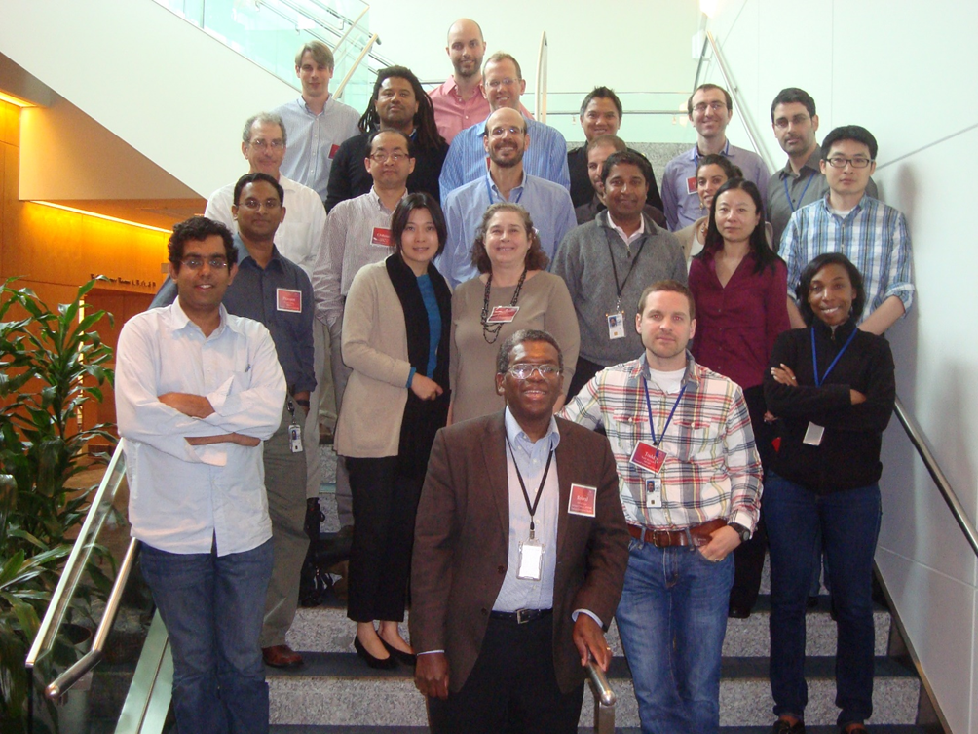
Approximately how many researchers are at NIH?
Full-Time Equivalent (FTE) Employees
821 Senior Investigators
217 Tenure-track Investigators
29 Senior Clinicians
44 Senior Scientists
29 Assistant Clinical Investigators
312 Staff Clinicians
1,428 Staff Scientists
275 Clinical Fellows
302 Research fellows
600 postbaccalaureate trainees
240 tenure-track investigators
As of Oct. 2019
For more in-depth demographics see:
https://oir.nih.gov/sourcebook/personnel/irp-demographics

Slide 14
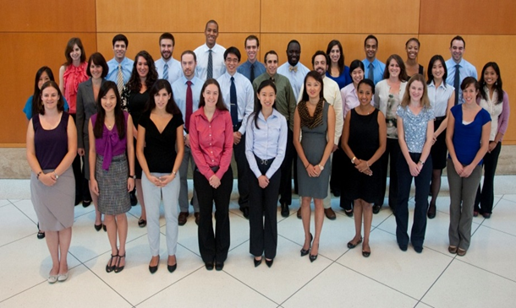
Approximately how many researchers are at NIH?
Non-FTE Trainees
2,308 Postdoctoral Fellows
391 Graduate/Medical/Dental students (long-term)
1,568 Post-Baccalaureate trainees
1,279 Summer Students
600 postbaccalaureate trainees
240 tenure-track investigators
Last updated Oct. 2019
For more in-depth demographics see:
https://oir.nih.gov/sourcebook/personnel/irp-demographics

Slide 15
Key Elements of Intramural Program
Intellectual freedom: ability to do high-risk, high- impact science because of a predominantly retrospective review system
Stable resources and funding for new technology and long-term projects
A critical mass of talent to collaborate with: recruitment from diverse sources, “an eye for talent”
The ability to respond rapidly to emerging public health problems
Leadership that recognizes the unique features of the NIH intramural program and preserves them – support for unconventional ideas

Slide 16
Distinctive Features of Intramural Research
Well-equipped, safe, modern research laboratories (5,571,000 net assignable sq. ft.)
State-of-the-art equipment
Extensive animal facilities
Effective technology transfer program

Slide 17
Distinctive Features of Intramural Research
Clinical Center-a hospital dedicated to research
Access to patients with rare diseases from across the U.S. and the world
ICs with specific disease orientations
Ability to respond quickly to public health threats (e.g. Ebola)

Slide 18
Key Intramural Achievements
Development of cell/tissue culture media and techniques
First cure of a solid tumor (choriocarcinoma) using chemotherapy
First clinical trial of lithium for depression
Critical contributions to understanding the cause, pathophysiology, and drugs for HIV-AIDS
Development of sequence similarity database searching and comparison
The first gene therapy clinical trial
Critical contributions to the development of the HPV vaccine to prevent cervical carcinoma
Research resulting in 5 Nobel Prizes, including the elucidation of the genetic code
  An additional 17 Nobel Prize winners were former trainees or employees of the NIH Intramural Research Program
  https://irp.nih.gov/about-us/honors

Slide 19
Selected Research Areas of Interest to Multiple Institutes
Chronic Inflammation
Gene and Cell-Based Therapies
Microbiome and Drug Resistance
Neuroscience of Compulsive Behaviors
Natural Products
RNA Biology and Therapeutics
Vaccines
See IRP long-term plan implementation from the June 11–12, 2015 ACD meeting
https://acd.od.nih.gov/meetings/meetings2011-2016.html

Slide 20
Scientific Director Responsibilities Include
Oversight of scientific organization, setting of overarching research priorities, and equitable allocation of resources within the IC’s intramural research program (IRP)
Recruitment and review of Principal Investigators and other key staff
Oversight of scientific mentoring, and training activities within the IRP
Oversight of budgets for intramural research and research-related expenses
Compliance with safety, ethics, and other legal and policy requirements
Clearance of manuscripts and other publications
Assurance of deposition of data and published manuscripts in appropriate public databases (e. g. PubMedCentral, ClinicalTrials.gov)
https://oir.nih.gov/sourcebook/board-scientific-directors

Slide 21
Scientific Director Responsibilities Include (cont.)
Contributing to the development and support of trans-NIH initiatives
Nomination of candidates for awards, prizes and lectures
Contributing to NIH-wide efforts to promote equity, civility, diversity, and inclusion
Active participation in the governance of the NIH IRP through participation in the Board of Scientific Directors
  Meetings first and third Wednesdays of each month
  Attendance is expected
https://oir.nih.gov/sourcebook/board-scientific-directors

Slide 22
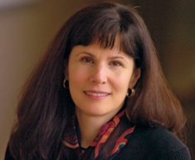
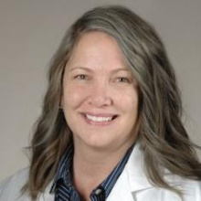
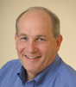

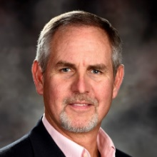
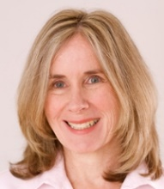

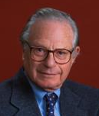
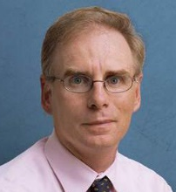
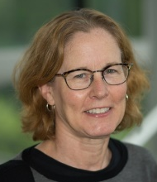
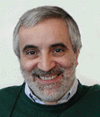
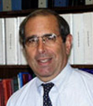
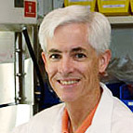

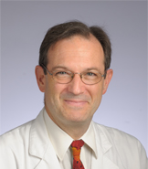
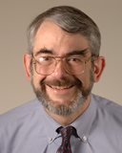
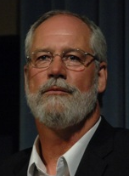
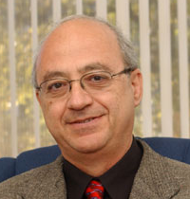
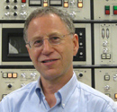
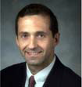
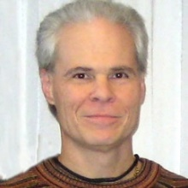
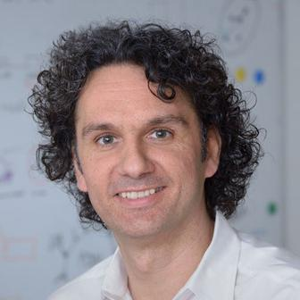
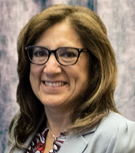
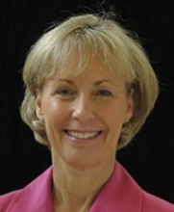
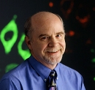
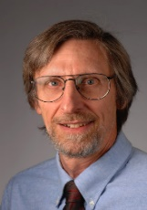
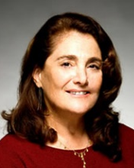
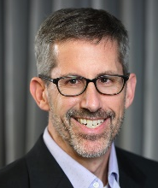

Susan Amara, Ph.D.
NIMH
Terri S. Armstrong, Ph.D., ANP-BC, FAAN, FAANP
NINR (Act.)
Robert Balaban,
Ph.D., NHLBI
Andy Baxevanis,
Ph.D. CIT (Act.)
Brian Berridge,
DVM, Ph.D., DACVP
NIEHS/DNTP
Catherine Bushnell,
Ph.D., NCCIH
Steven Chanock, M.D.,
NCI/DCEG
Milton Corn, MD,
NLM/LHC (Act.)
William Dahut, M.D. NCI /CCR (Clin)
Mary C. Dasso, Ph.D.
NICHD (Act.)
Luigi Ferrucci,
M.D., Ph.D.,
NIA
John Gallin, M.D.
CC
Andrew Griffith,
M.D., Ph.D.
NIDCD
Matthew Hoffman,
B.D.S., Ph.D.
NIDCR
Steven Holland, M.D
NIAID
Daniel Kastner,
M.D., Ph.D.
NHGRI
Michael Krause,
Ph.D.
NIDDK
George Kunos, M.D., Ph.D.
NIAAA
Richard Leapman,
Ph.D.
NIBIB
John R. Mascola, M.D.
VRC
Glenn Merlino, Ph.D.
NCI/CCR (Basic)
Tom Misteli, Ph.D.
NCI/CCR
Anna Napoles,
Ph.D., M.P.H
NIMHD
Amy Hauck Newman, Ph.D., NIDA (Act.)
SDs
February 2020
John J. O’Shea, M.D.
NIAMS
Jim Ostell, Ph.D.
NCBI/NLM (Act.)
Lorna Role, Ph.D. NINDS
David Schneeweis,
Ph.D. NEI (Act.)
Anton Simeonov
Ph.D., NCATS
Darryl Zeldin, M.D. NIEHS

Slide 23
Criteria for Scientific Review of Intramural Research
Significance [Is the PI studying an important problem?]
Approach [Is the PI studying the problem in an appropriate way (e.g., using the best model system?]
Innovation [Is the PI doing something that nobody else is doing?]
Environment [Has the PI made use of the special features of the IRP? Is there a research component that would be difficult to accomplish extramurally, with NIH grants?]
Support [Are the PI’s resource levels appropriate?]
Investigator training [Does the PI have the skills to do the proposed work?]
Productivity [Output relative to resources]
Mentoring [Is the PI promoting the career progression of trainees and staff?]
https://oir.nih.gov/sourcebook/processes-reviewing-nih-intramural-science
Notes:
23

Slide 24
Board of Scientific Counselors
The first Boards of Scientific Counselors (BSCs), constituted of scientists from outside NIH, were established in 1956 to review intramural research at NIH. The BSCs were established to assist the Scientific Directors in evaluating the quality of the intramural research programs for which they are responsible. To assure that the BSCs' evaluations will be most useful to the SDs in their decision making, the BSCs must be composed of individuals who themselves have outstanding scientific credentials and who are committed to providing rigorous, objective reviews.
Principal investigators with independent resources must be reviewed by a BSC at least once every four years
https://oir.nih.gov/sourcebook/processes-reviewing-nih-intramural-science/boards-scientific-counselors
Notes:
24

Slide 25
Tenure at the NIH
Tenure at the NIH is the commitment of salary to an independent Senior Investigator. Tenured Senior Investigators are granted independent resources (personnel, budget and space) by their Institute, and are required to have regular outside, expert review by Boards of Scientific Counselors. Resources may be adjusted up or down by the Institute, based on productivity and the quality of their work, as determined by these and other reviews.
https://oir.nih.gov/sourcebook/tenure-nih-intramural-research-program

Slide 26
Official Criteria for Tenure
High quality, originality and impact of scientific contributions to a specific field and biomedical research more generally
Independent creative effort
  Independent research as evidenced by primary and senior authorship on original research publications
  For team research, clear evidence of distinct intellectual contribution to the research; members of research teams should demonstrate peer recognition of their specific contributions and some publications should highlight their distinctive research
Productivity relative to resources
National/international recognition and leadership
https://oir.nih.gov/sourcebook/tenure-nih-intramural-research-program/criteria-tenure-nih

Slide 27
Official Criteria for Tenure (cont.)
Mentorship abilities and activities
Success in training and mentoring junior colleagues at all levels and from diverse backgrounds, as evidenced by their professional progress, competitive funding and/or publications
High ethical standards and integrity in directing and conducting research
NIH citizenship, collegiality and promotion of diversity
IC or NIH-wide activity or committee participation (e.g., Scientific Interest Group, IRB, ACUC, WSAs, Faculties, search committees, etc.), clinical service and other activities that promote the scientific enterprise at the NIH and more broadly
Active promotion of diversity through training and mentoring and/or recruitment and retention of talented researchers from diverse backgrounds underrepresented in biomedical research, including US Citizens or US Permanent Residents who are from underrepresented racial and ethnic groups (African American, Hispanic or Native American Indian/Alaska Native), persons with disabilities and women.

Slide 28
Documentation to Assess Fulfillment of the Criteria for Tenure
Updated and accurate C.V. and bibliography, including all necessary information that addresses the criteria for tenure
Letters of recommendation from the leaders in the field (at least 6 from non-collaborators)
BSC reports, with particular emphasis on the most recent one (must be within the past 2 years for the Central Tenure Committee); for team research, also include relevant sections of reports prepared by program-specific internal oversight and scientific advisory board(s) documenting creative and distinct contributions to team productivity
Recommending memorandum from the Laboratory/Branch Chief, team leader or Scientific Director, through IC Director, specifically addressing the recommendation for tenure
Report of the IC Promotion & Tenure Committee (only for tenure-track candidates)
https://oir.nih.gov/sites/default/files/uploads/sourcebook/documents/personnel/checksheet-tenure_appointment.pdf

Slide 29
Documentation to Assess Fulfillment of the Criteria for Tenure (cont.)
The 5 publications that the candidate considers most important
Description of future research plans by the candidate (no more than 5 pages)
Detailed description of the resources (budget, personnel, space, other) available to the candidate from the beginning of the tenure track to date, with a timeline of changes during the tenure track (only for tenure-track candidates); for team research, also include a summary of resources made available to the candidate as part of the team program

Slide 30
Management Controls Survey
Scientific Directors are responsible for conducting the intramural self-assessment of management controls
A committee of intramural management experts designed a self-assessment questionnaire form to be filled out by each Scientific Director every year
For details see:
https://oir.nih.gov/sourcebook/intramural-program-oversight/management-controls-survey
Notes:
30

Slide 31
Topics Covered in the Survey Include
Program and Project Planning/Management
  Protection of Human Subjects and Standards for Clinical Research
  Rules Covering Involvement of Intramural Scientists and Use of Intramural Facilities in NIH-Funded Extramural Projects
  Board of Scientific Counselor Reviews
  Animal Care and Use
  Scientific Misconduct
  Administrative Procedures
Health and Safety of Intramural Personnel
Recruitment, Appointment, Retention and Evaluation of Scientific and Technical Personnel
  Tenure Track
  Women and Minority Scientists
  Evaluation of Scientific and Technical Personnel
Conflict of Interest
Technology Transfer

Slide 32
Administrative Review of Scientific Directors
Each Scientific Director should be reviewed by an ad hoc external committee every four-to-six years or as the need arises.
The Scientific Director submits a progress report, covering the four-to-six year period since the previous review, to the chair of the ad hoc committee. This report should describe short-and long-term goals and program achievements since the previous review or since assuming the position of SD.
Ad hoc committee conducts review of the Scientific Director which should include interviews with the Scientific Director, Lab/Branch Chiefs, IC scientists at all levels, the IC Director, and the DDIR. Letters of reference may be solicited as appropriate.
Chair, ad hoc committee, submits a report to the Advisory Council or Board, via the IC Director, entitled "Review of the Scientific Director (IC)".

Slide 33
The NIH Equity Committee
The NIH Equity Committee was established in response to the recommendations of the Task Force on Gender Inequity in the NIH Intramural Research Program.
Its charge is to support efforts to assure equity at the NIH by the Scientific Directors.
The NEC meets monthly to consider, from each intramural program, demographic data and plans to improve the representation and environment for women and other scientists under-represented at the NIH.
Approximately once per year, each Scientific Director will present at the NIH Equity Committee.

Slide 34
Scientific Review of Scientific Directors’
Independent Research
Scientific Directors with independent research resources must undergo BSC review at least once every 4 years.
The NIH Deputy Director for Intramural Research or his/her designee must be present for the report of the BSC to the IC Director, when a Scientific Director is reviewed by the BSC.

Slide 35
Mandated Training for Scientific Staff Working in
NIH Facilities
The Scientific Director is ultimately responsible for assuring that all scientific staff within her/his IC are properly trained.
Mandated training includes:
  Introduction to Laboratory Safety https://www.safetytraining.nih.gov/default.aspx?m=Please-Log-In
  Introduction to the Responsible Conduct of Research
  NIH Computer Security & Privacy Awareness
  NIH Environmental Management (NEMS) Awareness
  NIH Prevention of Sexual Harassment
  Protection of Human Research Subjects
  Technology Transfer Online Training
  https://oir.nih.gov/sourcebook/personnel/recruitment-processes-policies-checklists/mandated-training-scientific-staff-working-nih-facilities

Slide 36
Key Resources
Scientific Directors listserve (see your OIR contact to be added)
Scientific Directors Sharepoint website (see your OIR contact for access) http://www.od.nih.gov/ScientificDirectors/default.aspx
The Office of Intramural Research (OIR) https://oir.nih.gov/
OIR Sourcebook https://oir.nih.gov/sourcebook
Searchable database of all NIH intramural research projects http://intramural.nih.gov/search/index.tml
Intramural Principal Investigators sorted by research area or name https://irp.nih.gov/our-research/principal-investigators
Notes:
36

Slide 37
The Shared Resources Subcommittee (SRS) of the Board of Scientific Directors
The SRS oversees multiple trans-NIH initiatives and facilities, supported by voluntary contributions from the IC IRPs.
Contributions are based partly on the size of the IC IRP’s budget and partly on the IC’s use of the facility.
For more information see:
https://oir.nih.gov/sourcebook/board-scientific-directors/board-scientific-directors-sub-committees

Slide 38
SRS-Supported Activities
NIH Collaborative Research Exchange (CREx) https://nih.scientist.com/users/sign_in
NIH MRI Research Facility (NMRF)
Research Positron Emission Tomography Facility
Chemistry Resource Center (former IPDC)
Advanced Imaging & Microscopy Resource (AIM)
Biomedical Engineering and Physical Science Shared Resource (BEPS)
Trans-NIH RNAi Facility
NIH MRI Research Facility (NMRF)
NIH Mouse Imaging Facility (MIF)
For more information see: https://irp.nih.gov/our-research/research-resources

Slide 39
SRS-Supported Activities (cont.)
Promoting the NIH Intramural Research Program https://irp.nih.gov/
NIH Oxford-Cambridge Scholars Program (Ox/Cam) https://oxcam.gpp.nih.gov/index.asp
Stadtman and Lasker recruitments (advertising, outreach and website) https://irp.nih.gov/careers/trans-nih-scientific-recruitments
Office of Intramural Training and Education (OITE) https://www.training.nih.gov/
Graduate Partnerships Program (GPP) https://www.training.nih.gov/programs/gpp
NIH Medical Research Scholars Program (MRSP) https://clinicalcenter.nih.gov/training/mrsp/
Purchasing Online Tracking System (POTS) http://tutorialdev.ninds.nih.gov/webhelp/

Slide 40
Other Shared and Central Research Resources
DDIR Innovation Awards https://oir.nih.gov/about/ddir-innovation-awards
NIH Library https://nihlibrary.nih.gov/agency/nih
NIH Clinical Center https://clinicalcenter.nih.gov/

Slide 41
Selected Trans-NIH
Career Development and Recruitment Programs
The Undergraduate Scholarship Program (UGSP) https://www.training.nih.gov/programs/ugsp
Medical Research Scholars Program (MRSP) https://www.cc.nih.gov/training/mrsp/index.html
Independent Research Scholars Program https://oir.nih.gov/sourcebook/personnel/ipds-appointment-mechanisms/research-fellow/independent-research-scholar-program
Earl Stadtman Investigator Search http://irp.nih.gov/careers/trans-nih-scientific-recruitments/stadtman-tenure-track-investigators
NIH Lasker Clinical Research Scholars Program http://www.nih.gov/science/laskerscholar/index.html

Slide 42
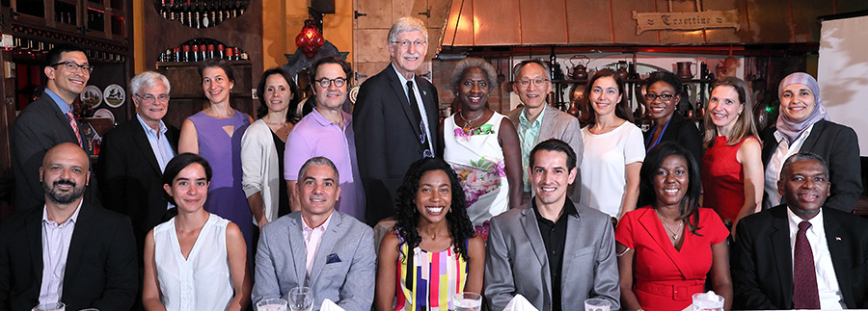
The NIH Distinguished Scholars Program
Funded by contributions from NIH Institutes and Centers
Goals:
  To stimulate institutional transformation by recruiting a substantial number of PIs with a demonstrated commitment to diversity and inclusion
  Provide start-up funds, professional development, mentoring and networking opportunities
https://diversity.nih.gov/programs-partnerships/dsp

Slide 43

Annual PI Leadership Workshop Series for New Junior PIs, Organized by OIR

Slide 44
Selected Topics from PI Workshops for FY2020
Setting up group policies (“Welcome to my Group” letters)
Hiring
Motivating your staff
Understanding the NIH tenure process
Team Science
Emotional Intelligence
Harnessing diversity
Feedback

Slide 45
Additional Mentoring for Tenure-Track Investigators and Assistant Clinical Investigators
All junior faculty are required to have at least two mentors (usually a mentoring committee)
Women Scientists Advisors mentoring groups
MOMDADOCs (open to all NIH Scientists)
At-large Mentors
  Dr. Carl Hashimoto OIR/OSWD
  Dr. Roland Owens OIR

Slide 46
NIH Organizations Which Support Trainees
NIH Office of Intramural Training & Education https://www.training.nih.gov/
NIH Fellows Committee (FELCOM) https://www.training.nih.gov/felcom
IC Training Contacts
https://www.training.nih.gov/ic_contacts
Committee on Scientific Conduct and Ethics (CSCE) https://oir.nih.gov/sourcebook/committees-advisory-ddir/committee-scientific-conduct-ethics-csce

Slide 47
Selected Educational and Informational Resources
"Becoming a Responsible Scientist": Ethics Training at the NIH https://www.training.nih.gov/ethics_training_home_page
Wednesday Afternoon Lecture Series (WALS)
  https://oir.nih.gov/wals
Clinical Center Grand Rounds http://clinicalcenter.nih.gov/about/news/grcurrent.html
NIH Director’s Seminar Series https://www.nih.gov/about-nih/who-we-are/nih-director/directors-seminar-series
NIH guidelines for Social Media at: http://employees.nih.gov/pages/social-media/

Slide 48
Selected Educational and Informational Resources (cont.)
Over 100 scientific interest groups https://oir.nih.gov/sigs
Other Affinity Groups https://www.training.nih.gov/you_are_not_alone
FAES courses https://faes.org/
Demystifying Medicine http://demystifyingmedicine.od.nih.gov
NIH Research Festival (each fall) https://researchfestival.nih.gov/2019
NIH Citaton Analysis Tool https://icite.od.nih.gov/analysis
Rigor and Reproducibility https://www.nih.gov/research-training/rigor-reproducibility

Slide 49
Bridge Research Grants for Senior Fellows
K99/R00 grants https://oir.nih.gov/sourcebook/awards-fellowships-grant-opportunities/k99r00-grant-award-information
Also see: https://oir.nih.gov/sourcebook/awards-fellowships-grant-opportunities/early-career-bridge-awards-open-irp-scientists

Slide 50
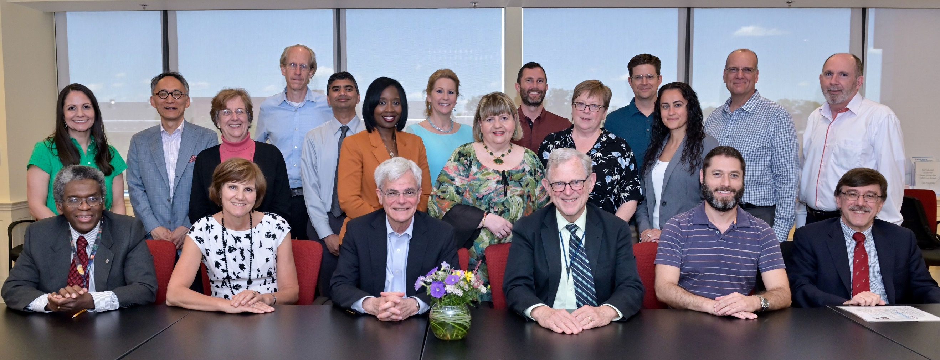
Office of Intramural Research Leadership and Staff
https://oir.nih.gov/about/leadership-staff

Slide 51
Additional Key Web Sites
NIH Intramural Research Program
http://irp.nih.gov/
Searchable database of all NIH intramural research projects
http://intramural.nih.gov/search/index.tml
Intramural Training Opportunities http://www.training.nih.gov
Deputy Director for Intramural Research Webboard
(NIH Access Only) http://ddir.nih.gov
The NIH Catalyst http://irp.nih.gov/catalyst
Michael Gottesman’s editorials from The NIH Catalyst
http://ddir.nih.gov/Editorials.html

Slide 52
Questions?

